Slide 1








Flair Analytics, Baramati, MH, India.
Complete Master of Engineering.
Power BI, Prepare report, dashboard.
SQL server, SQL database, Data lake etc.
Mr. Amol Kokare
.Net, create Web API, Web development.
Ceo, Flair Analytics.
Microsoft Azure portal.
Python, Analysis, Machine learning Analytics.

Slide 2
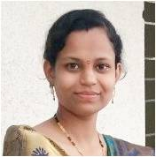


Flair Analytics, Baramati, MH, India.
Complete Master of Computer Engg.
Mongo-Db Database, Apply query, handle from python.
SQL server.
Mrs. Apurva Mane
.Net, create Web API, Web development.
Software Developer, Flair Analytics.
React JS , Website development.
Python, Analysis, Machine learning Analytics, Pandas.

Slide 3
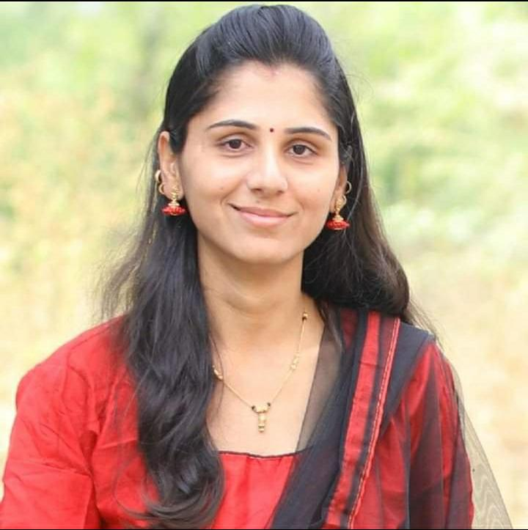

Flair Analytics, Baramati, MH, India.
Complete Master of Computer Engg.
Ruby on Rails, Website Development.
SQL server, Backend Database handling.
Mrs. Rakhi Deokate
.Net, create Web API, Web development.
Web Developer,
Flair Analytics.
React JS , Website development.
Python, Analysis, Machine learning Analytics.

Slide 4


Flair Analytics, Baramati, MH, India.
Complete Master of Computer Science.
Power Apps, Microsoft Dynamics 365.
Power BI, Prepare report, dashboard.
Mr. Shubham Chavan
.Net, create Web API, Web development.
Software Developer, Flair Analytics.
React JS , Website development.
Python, Analysis, Machine learning Analytics.

Slide 5
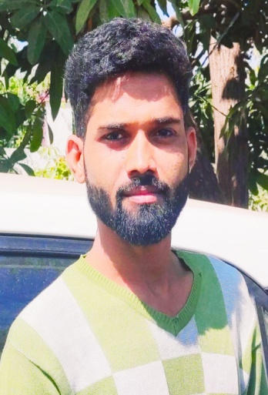
Flair Analytics, Baramati, MH, India.
Complete Bachelor of Engineering.
Power Apps, Microsoft Dynamics 365.
Power BI, Prepare report, dashboard.
Mr. Yogesh Rupnawar
.Net, create Web API, Web development.
Application Developer, Flair Analytics.
React JS , Website development.
Python, Analysis, Machine learning Analytics.

Slide 6
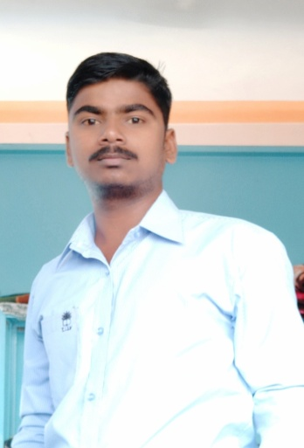

Flair Analytics, Baramati, MH, India.
Complete Master Computer Applications.
Ruby on Rails, Website Development.
SQL server, Backend Database handling.
Mr. Ravindra Londhe
.Net, create Web API, Web development.
Website Developer, Flair Analytics.
React JS , Website development.
Html, CSS, Bootstrap.

